Slide 1

Alabama Veterans Museum
Presented By John Michael Raimondi and Ben Ward
Sprint 2 Presentation

Slide 2
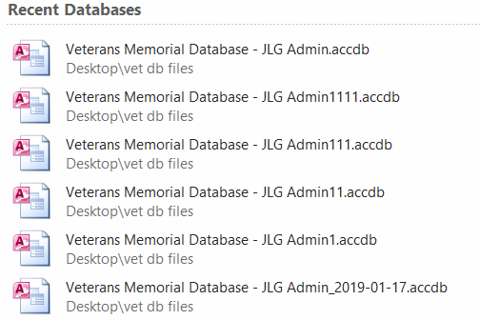
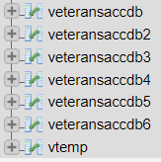
Access to SQL - Migration

Slide 3
Access to SQL - Merging
INSERT INTO vtemp (ID, FName, MName, LName, Suffix, DOB, DOD, CName, CSection, CRow, MarkerPicLoc, MarkerLocation,
MiscPicLoc, Branch1, Rank1, Branch2, Rank2, Conflict1, Conflict2, Conflict3, Awards, MilPicLoc, Comments)
SELECT DISTINCT
ID, FNAME, MNAME, LNAME, SUFFIX, DOB, DOD, CEMETERY, SECTION, ROW, `MARKER PHOTO`, `MARKER LOCATION`, `MISC PHOTO`, BRANCH1, RANK1, BRANCH2, RANK2, CONFLICT1, CONFLICT2, CONFLICT3, `AWARDS/ DECORATIONS`, `MILITARY PHOTO`, `REMARKS/ COMMENTS`
FROM(
SELECT
ID, FNAME, MNAME, LNAME, SUFFIX, DOB, DOD, CEMETERY, SECTION, ROW, `MARKER PHOTO`, `MARKER LOCATION`, `MISC PHOTO`, BRANCH1, RANK1, BRANCH2, RANK2, CONFLICT1, CONFLICT2, CONFLICT3, `AWARDS/ DECORATIONS`, `MILITARY PHOTO`, `REMARKS/ COMMENTS`
FROM
veteransaccdb AS V
UNION
SELECT
[...]
UNION
SELECT
ID, FNAME, MNAME, LNAME, SUFFIX, DOB, DOD, CEMETERY, SECTION, ROW, `MARKER PHOTO`, `MARKER LOCATION`, `MISC PHOTO`, BRANCH1, RANK1, BRANCH2, RANK2, CONFLICT1, CONFLICT2, CONFLICT3, `AWARDS/ DECORATIONS`, `MILITARY PHOTO`, `REMARKS/ COMMENTS`
FROM
veteransaccdb6) V;

Slide 4


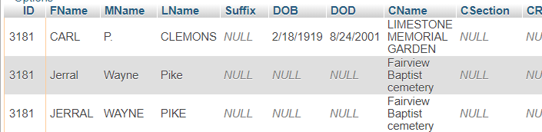

Access to SQL - Duplicates

Slide 5

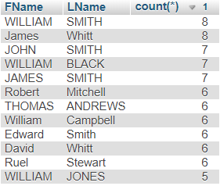
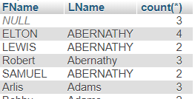
Access to SQL - Duplicates

Slide 6
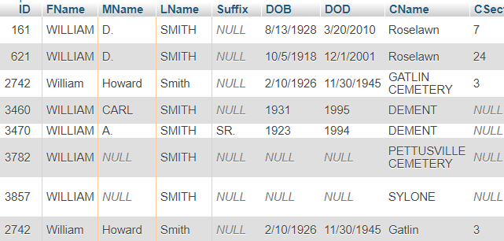
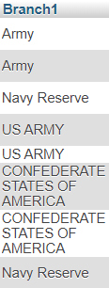

Access to SQL - Duplicates

Slide 7



Access to SQL - Duplicates
Cemetery names
-Minor text differences
-Spaces

Slide 8
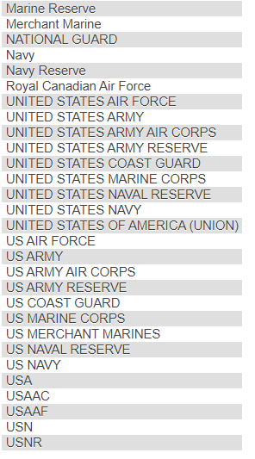

Access to SQL - Duplicates
Branch names
-Abbreviations
-Shortened/Full length

Slide 9
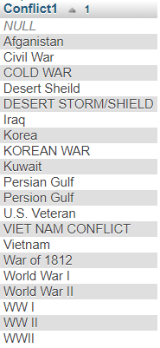

Access to SQL - Duplicates
Conflict names
-Spelling errors
-Alternate names
-Shortened/Full length

Slide 10
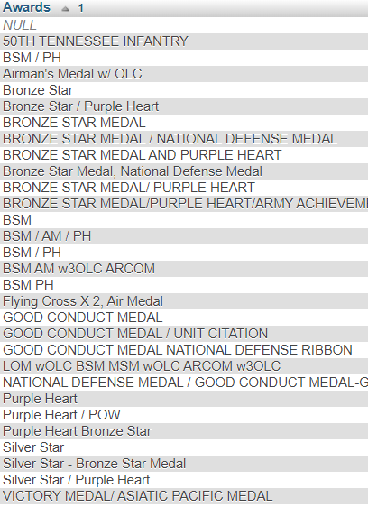

Access to SQL - Duplicates
Award names
-Abbreviations/Full length
-Multiple entries
-Alternate names

Slide 11
Access to SQL - Duplicates
Options moving forward
-Fix Branch/CName/Conflict at access side and reimport
-Learn more SQL
-Ignore certain fields when searching for duplicates

Slide 12
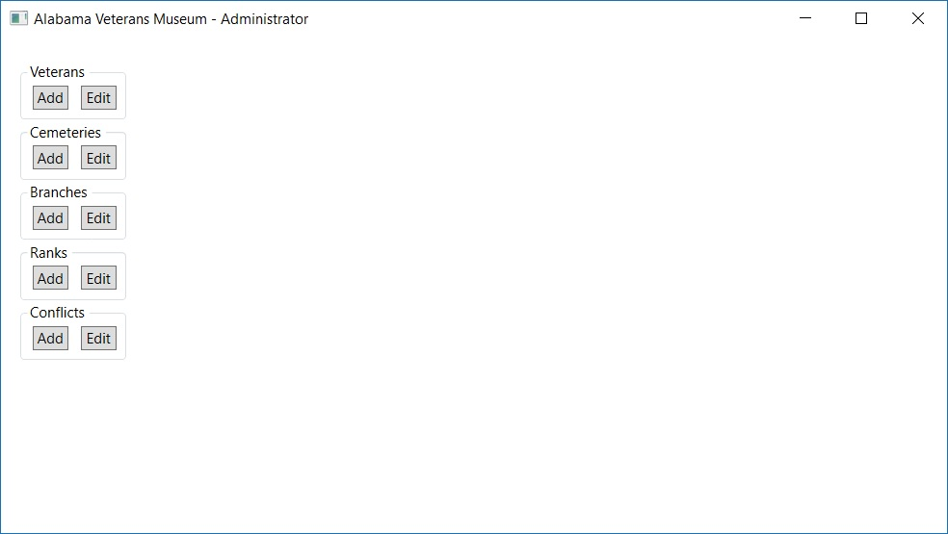
Admin Application – Initial Design

Slide 13
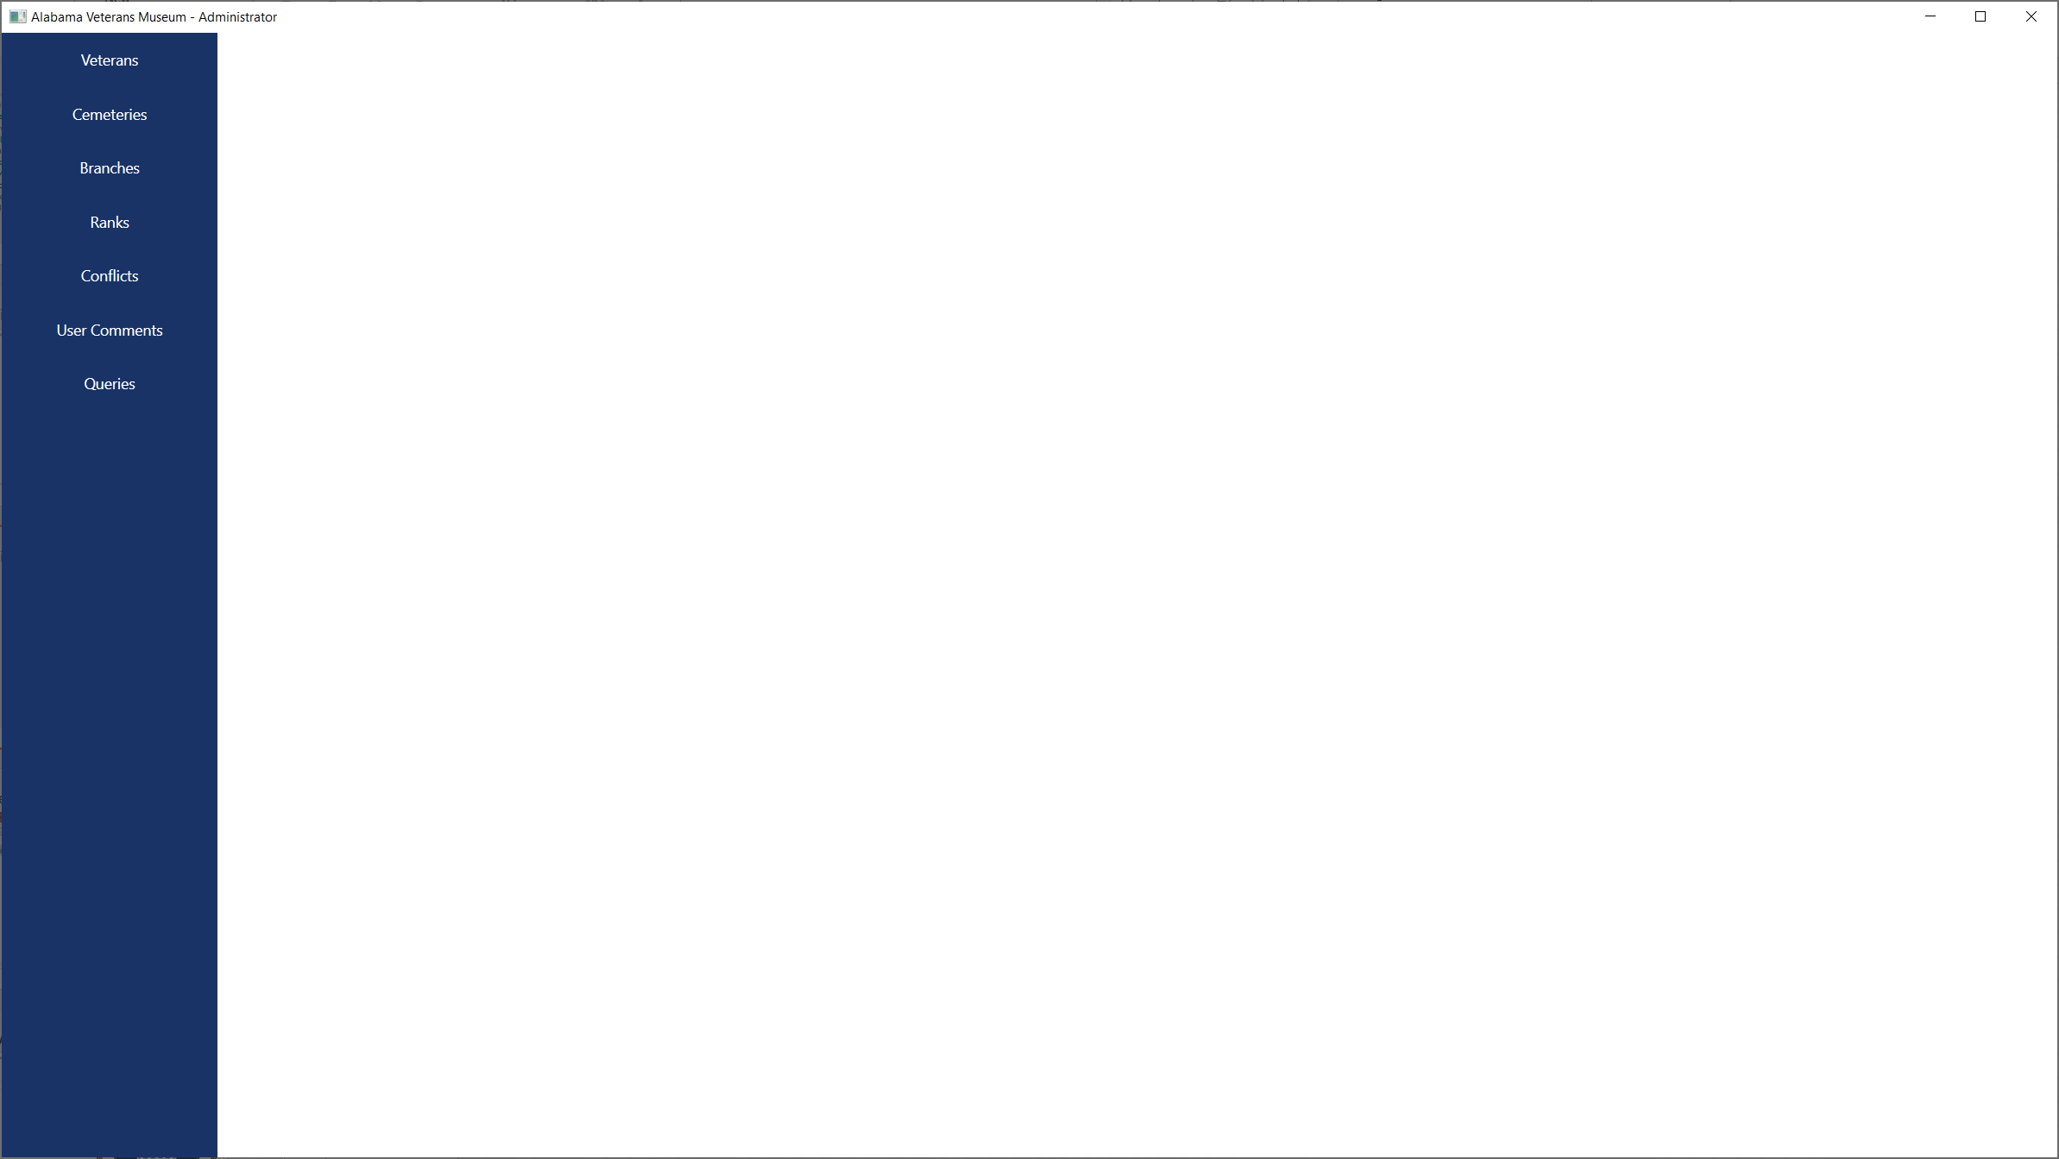
Admin Application – Main Window

Slide 14
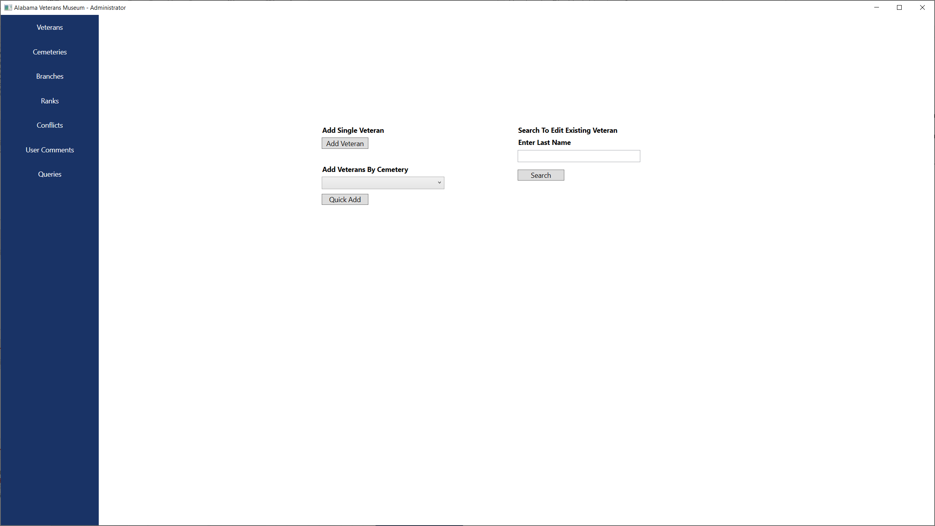
Admin Application – Veterans Window

Slide 15
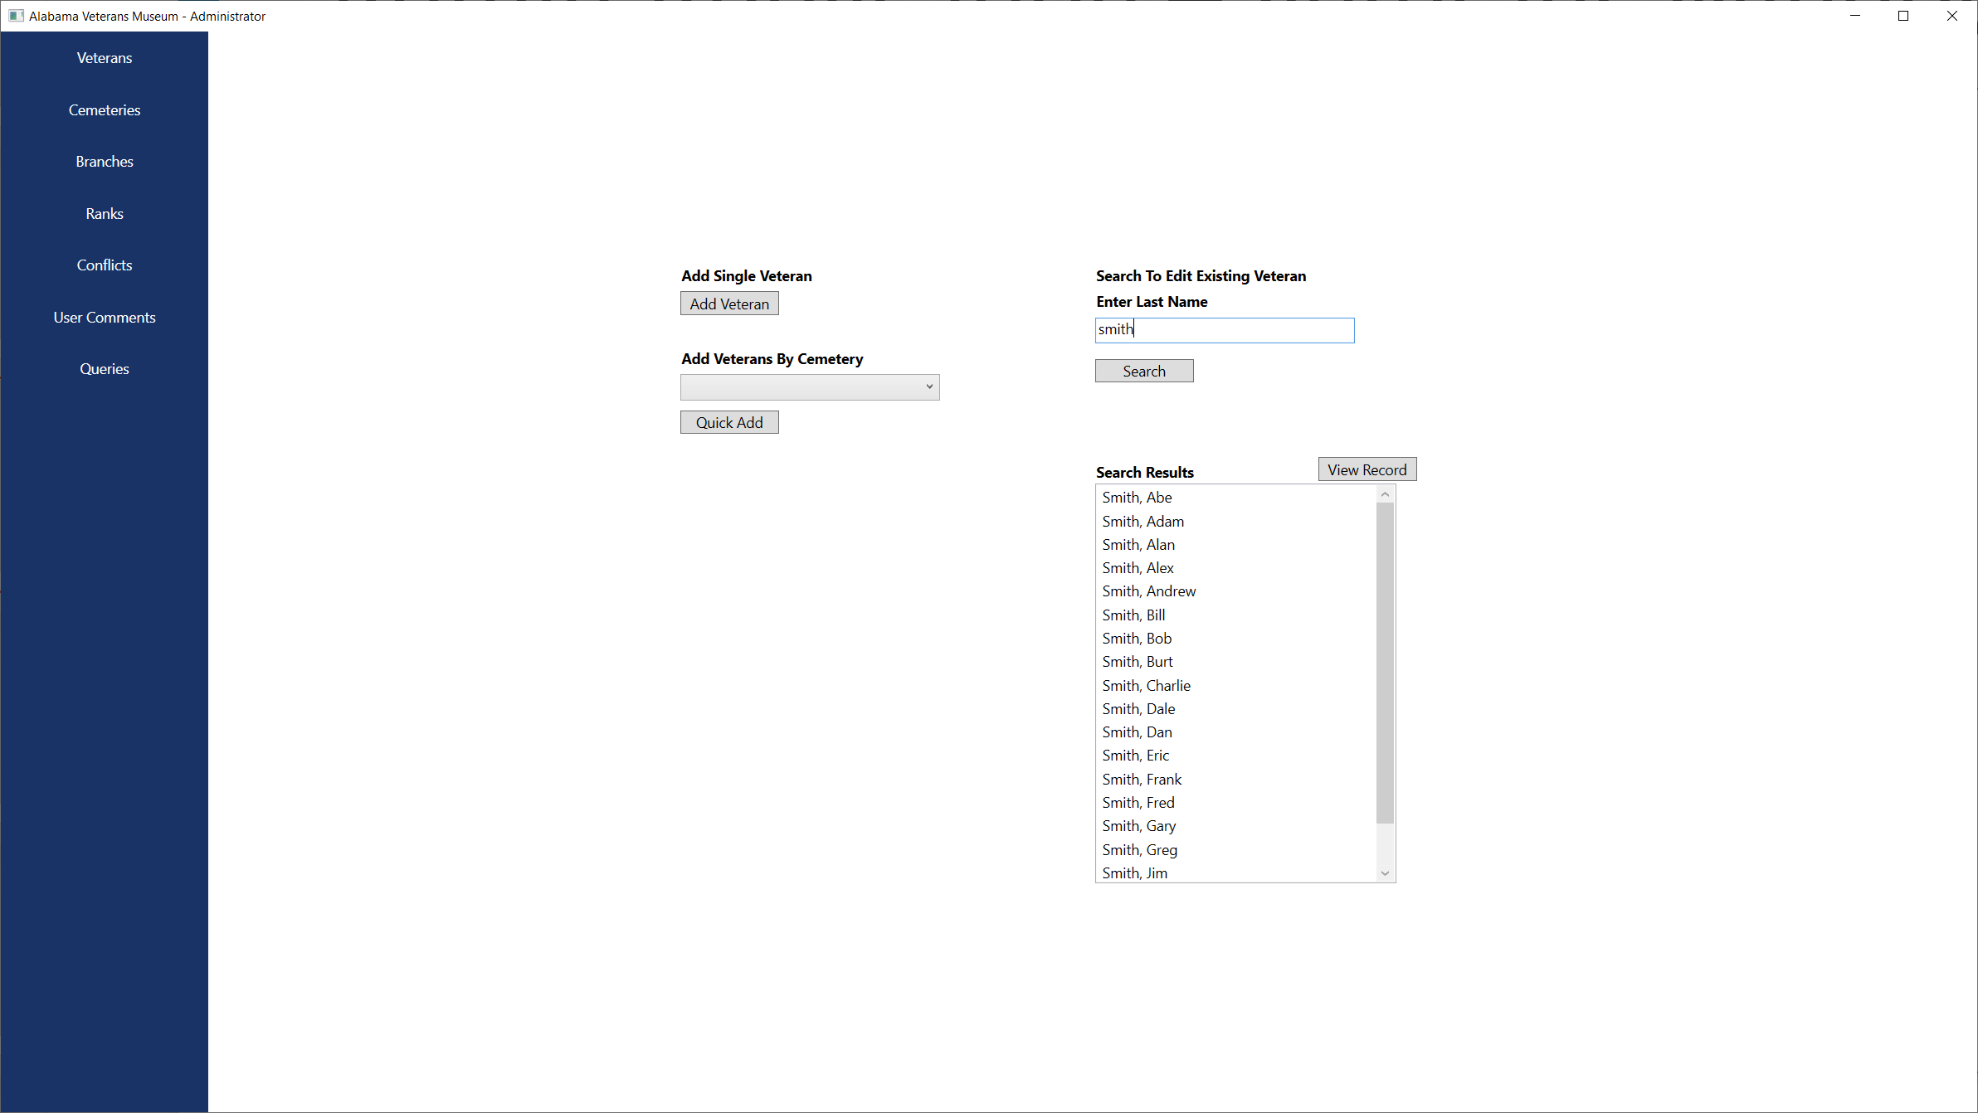
Admin Application – Veterans Window

Slide 16
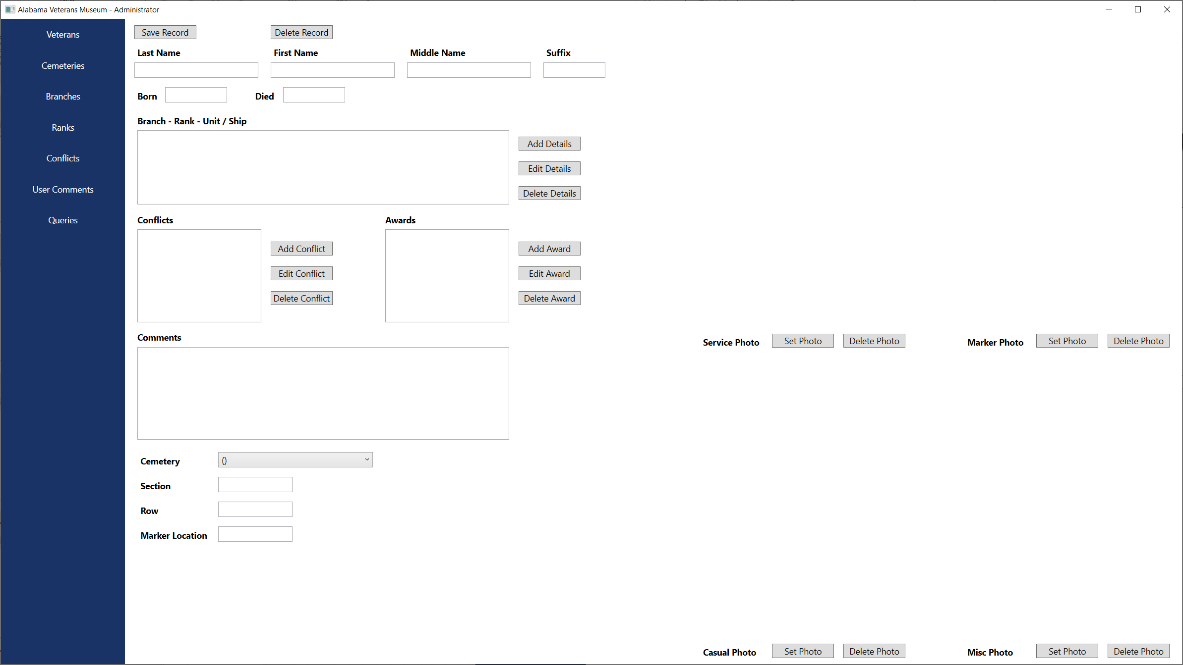
Admin Application – New Veteran

Slide 17
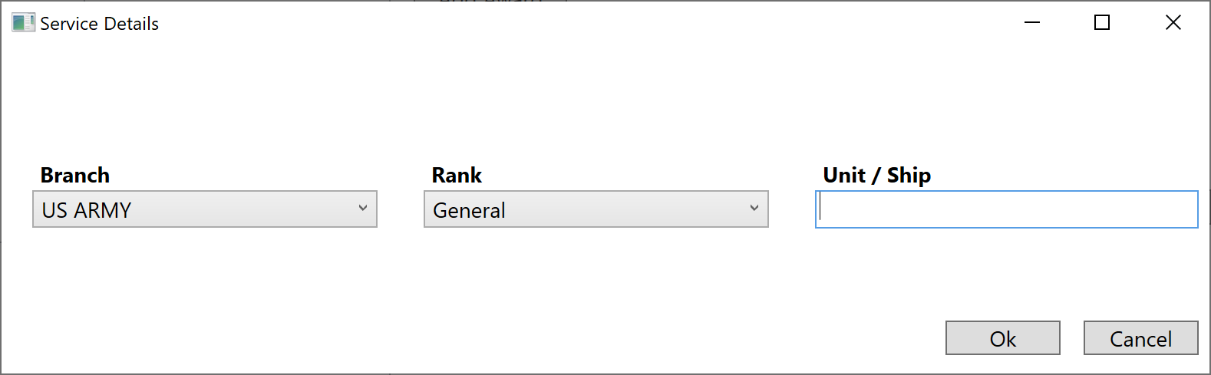
Admin Application – Service Details

Slide 18
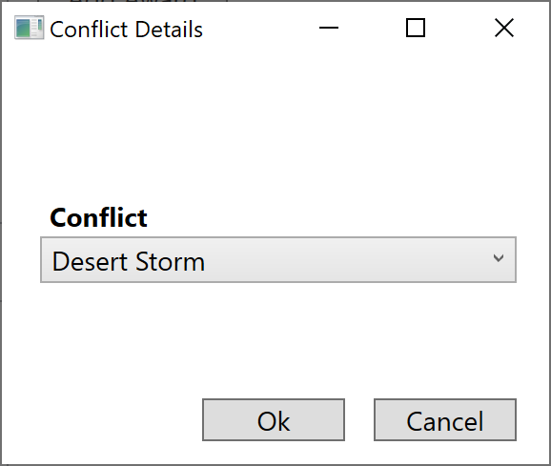
Admin Application – Conflict Details

Slide 19
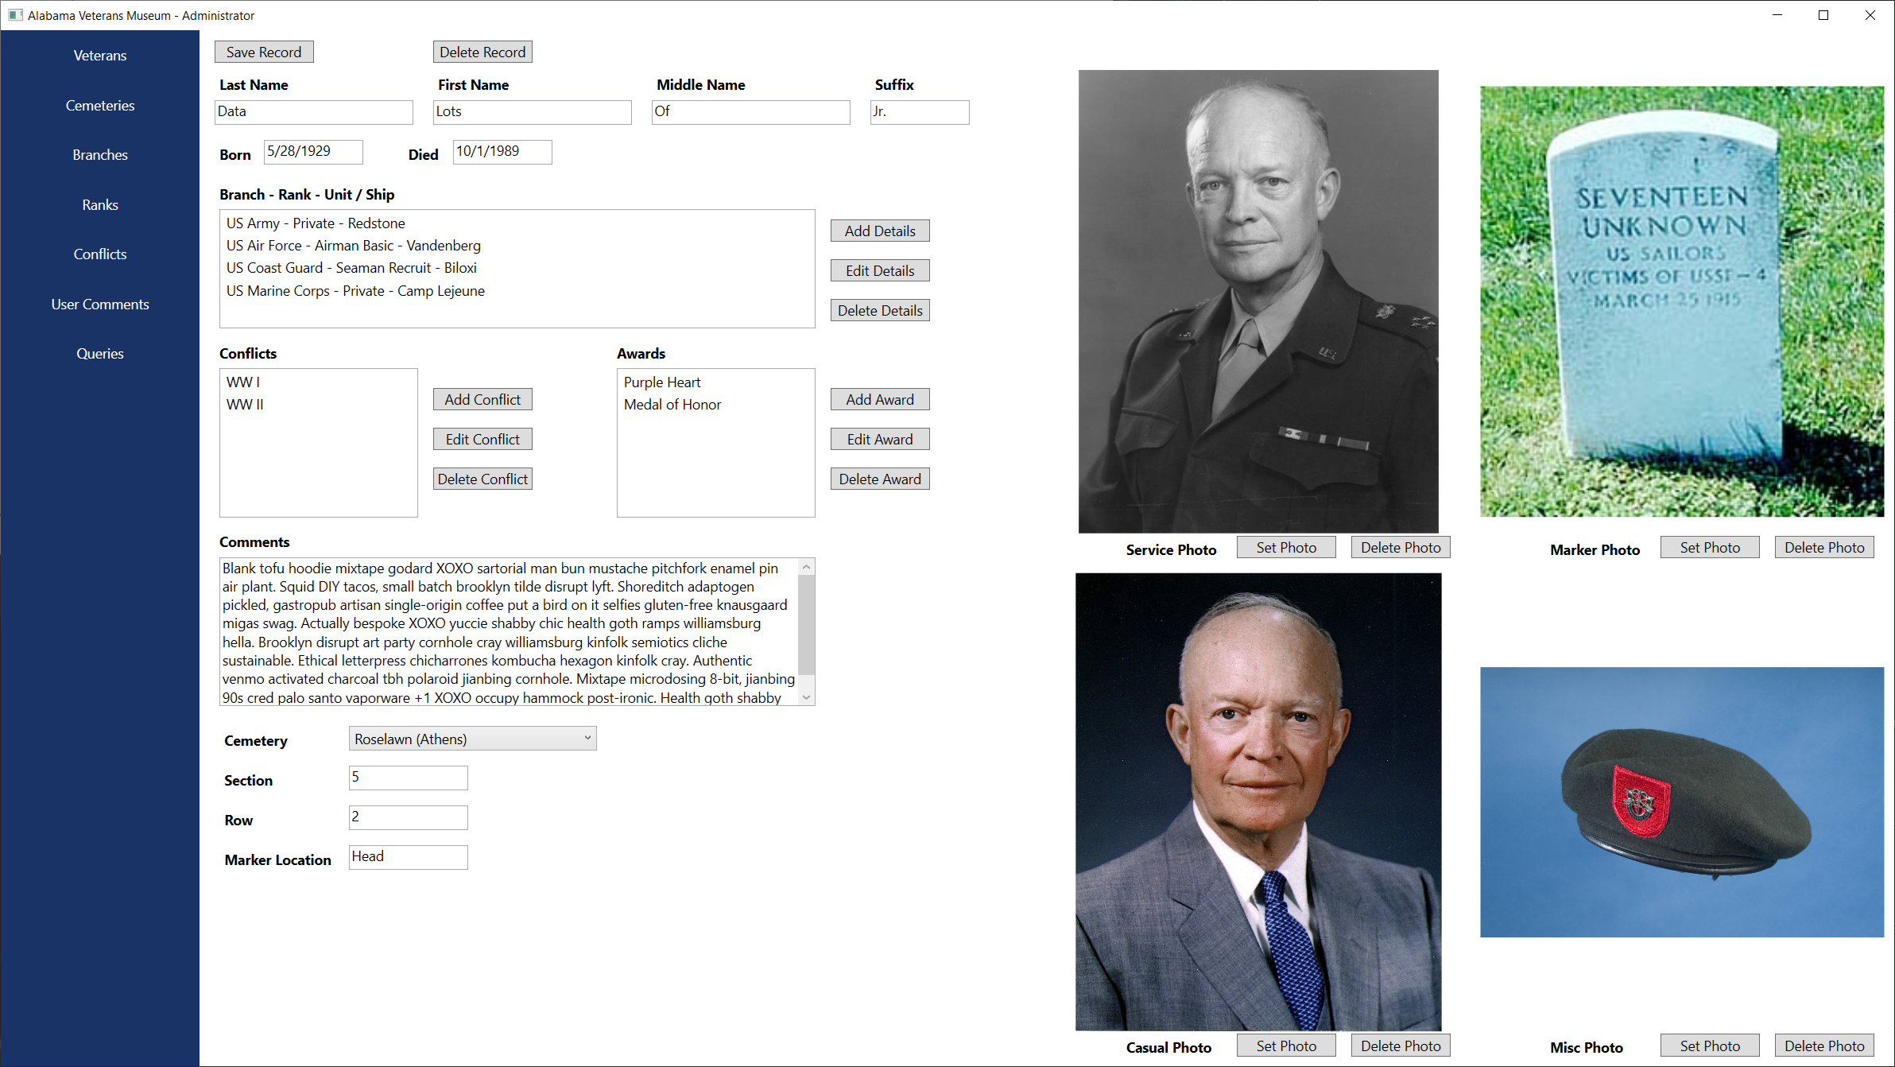
Admin Application – Edit Veteran

Slide 20
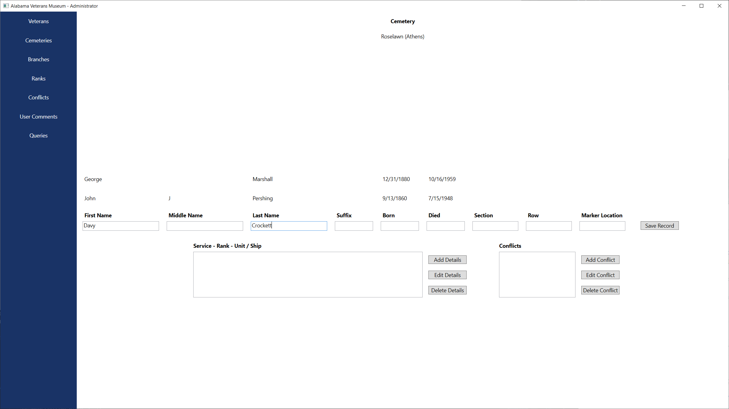
Admin Application – Add Veteran By Cemetery

Slide 21
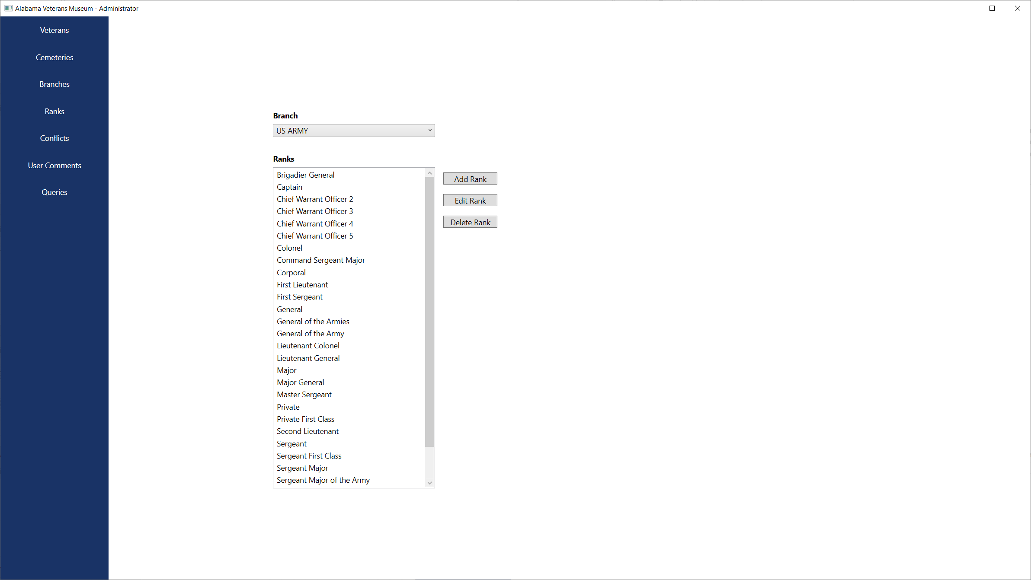
Admin Application – Ranks Window

Slide 22
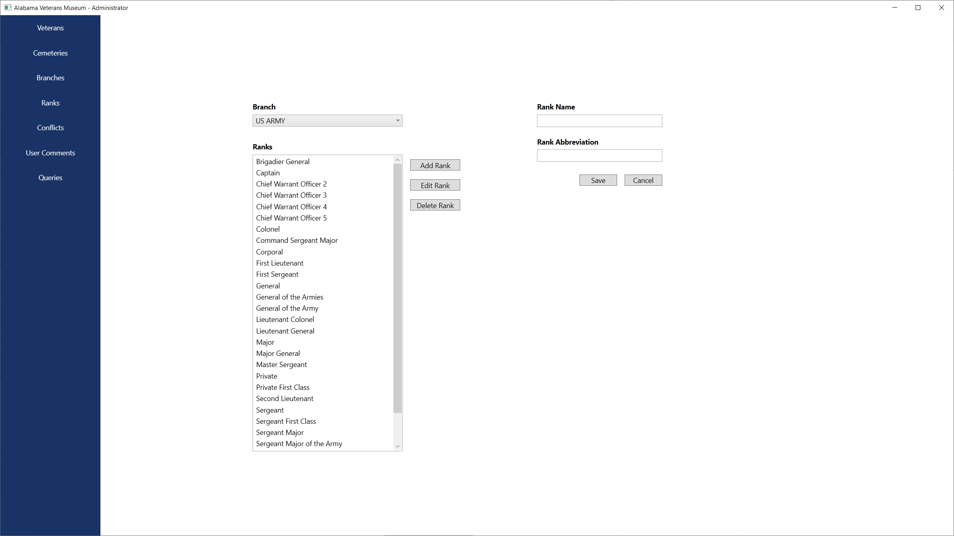
Admin Application – Add Rank

Slide 23

Admin Application – Edit Rank

Slide 24
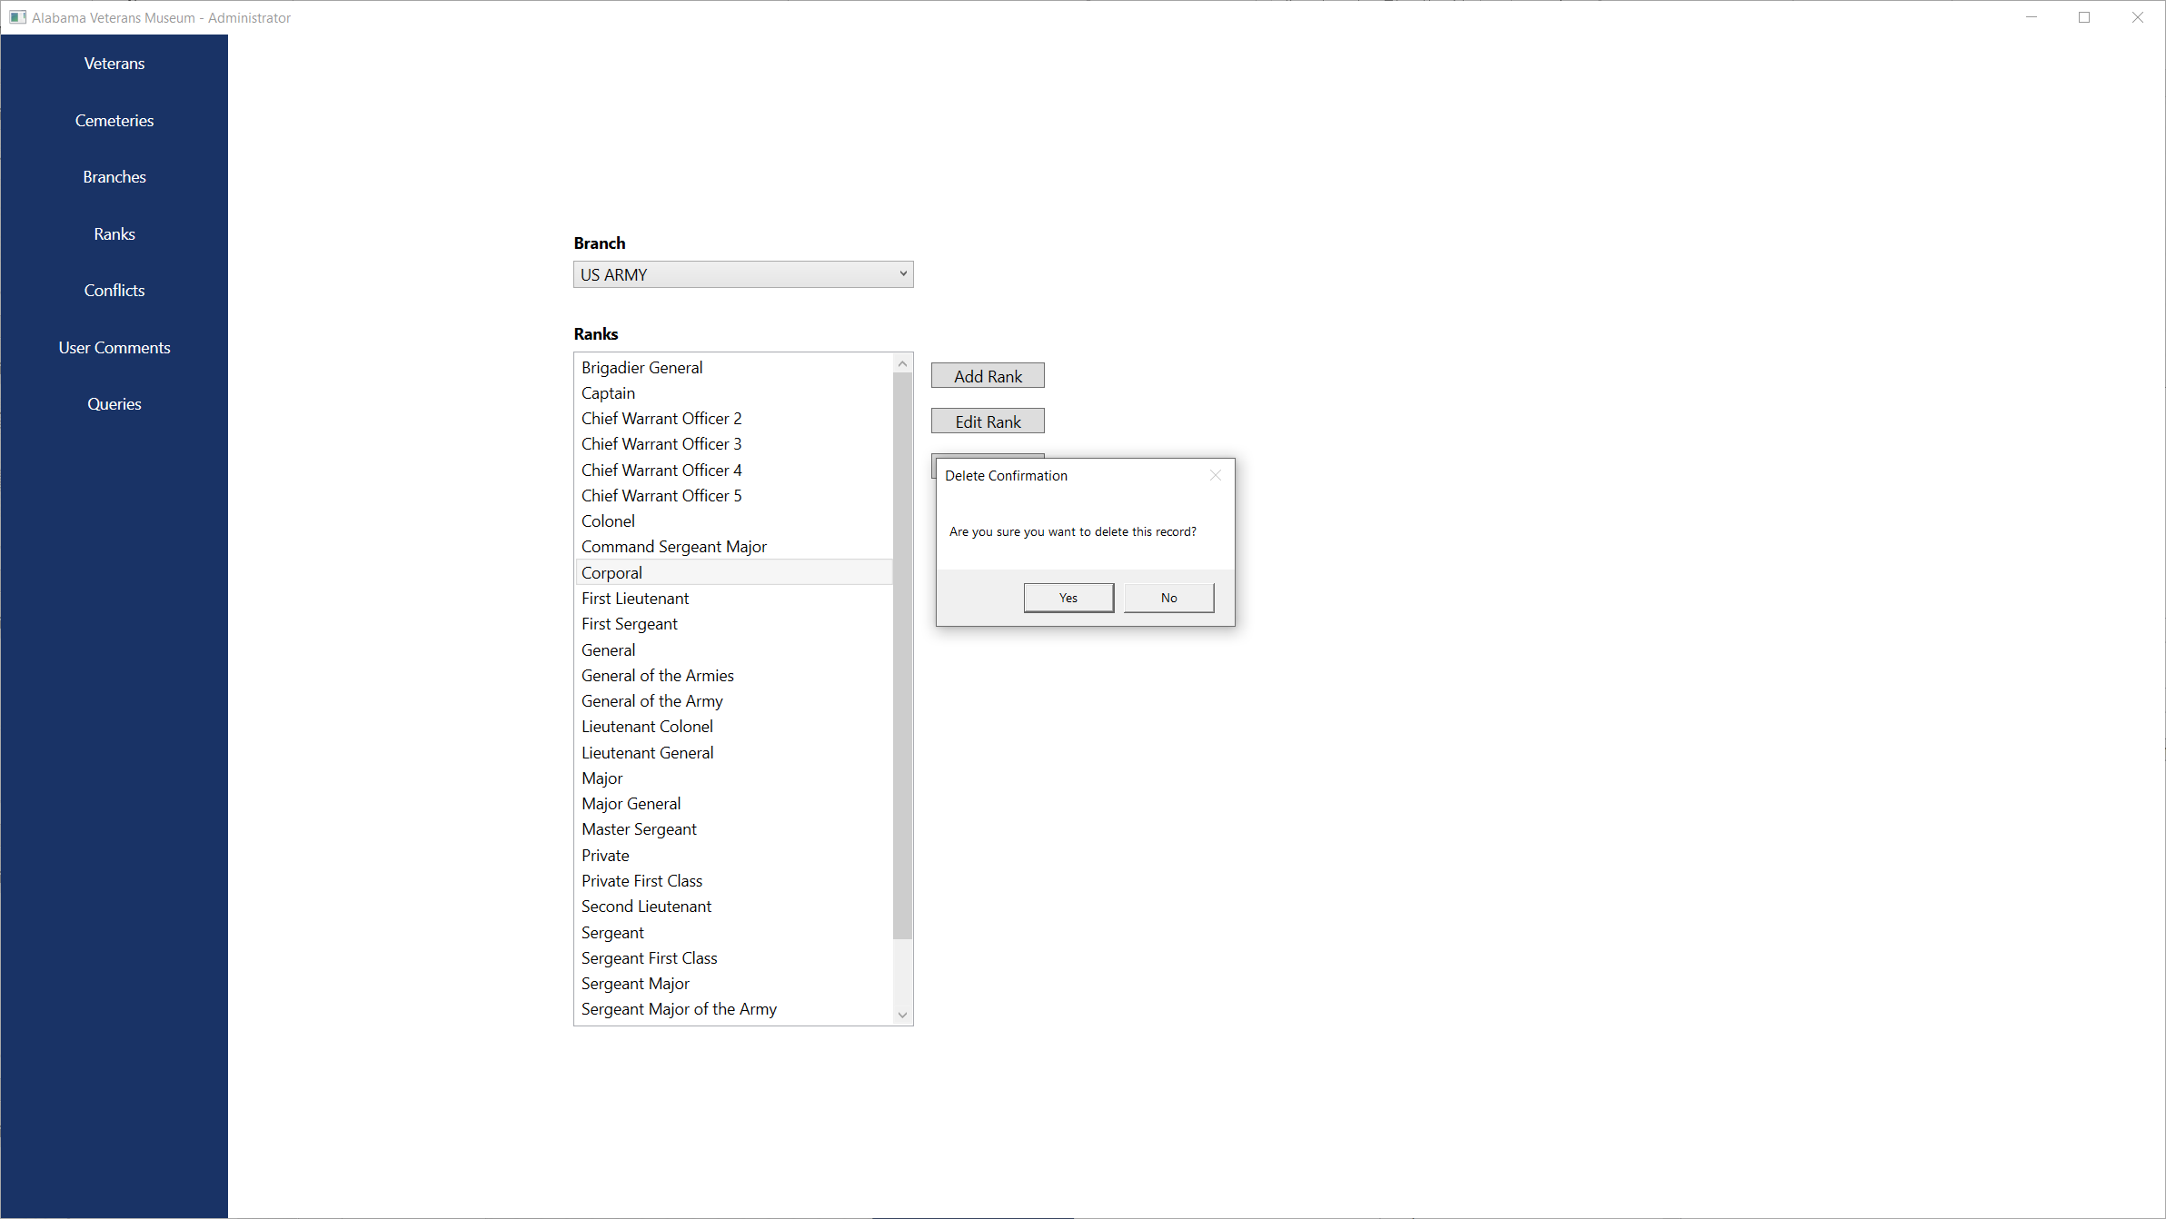
Admin Application – Delete Rank

Slide 25

THANK YOU FOR YOUR TIME

